Slide 1
Judgment and Decision Making 2
Sumitava Mukherjee

Slide 2
Real life : Weather
https://bit.ly/rainprob

Slide 3
Probability: The naïve understanding
Mostly it means likelihood
https://www.youtube.com/watch?v=pYxNSUDSFH4
It could also mean uncertainty, propensity, probability (future event), plausibility, degree of surprises, etc.
Pragmatic position. But this is not a problem as people do respond and use. It is better understood than “nanobility”.

Slide 4
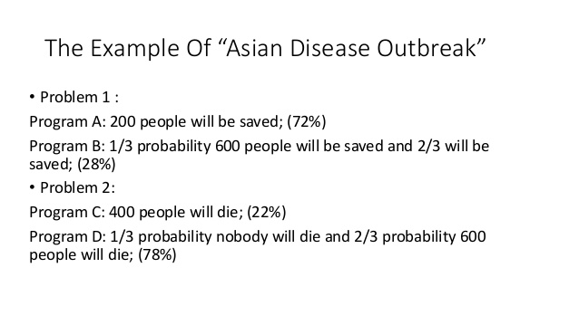
Decisions under risky frames

Slide 5
A world of risk and uncertainty
What is Risk?
  The predominant understanding is related to a negative / loss orientation
  The less dominant understanding is of statistical underlying of a distribution of possibilities
  Although risk is a statistical reality, it is often connoted with loss

Slide 6
Defining Risk
Oxford dict: “the possibility of loss, injury, or other adverse or unwelcome circumstance; a chance or situation involving such a possibility”.
ISO
  effect of uncertainty on objectives
  [An effect is a deviation from the expected – positive or negative.
  Objectives can have different aspects (such as financial, health and safety, and environmental goals) and can apply at different levels (such as strategic, organization-wide, project, product and process).

Slide 7
Uncertainty
Imperfect or unknown information
Uncertainty arises in partially observable and/or stochastic environment
Frank Knight distinguished uncertainty from risk: Uncertainty: lack of knowledge, immeasurable and impossible to calculate

Slide 8
Uncertainty is always linked to information
There are some things that you know to be true, and others that you know to be false; yet, despite this extensive knowledge that you have, there remain many things whose truth or falsity is not known to you. We say that you are uncertain about them. You are uncertain, to varying degrees, about everything in the future; much of the past is hidden from you; and there is a lot of the present about which you do not have full information. Uncertainty is everywhere and you cannot escape from it.
Dennis Lindley, Understanding Uncertainty (2006)

Slide 9
What happens under uncertainty?
The panic of emotional circuit: Limbic system
Mainly associated with negative affect (although under hope/aspiration/optimism, it can result in positive affect)
People simulate the future (“mental simulations” to assign probabilities under uncertainty and get a sense. This functioning of the brain is similar to prediction models.

Slide 10
What happens under uncertainty?
Prediction models: Will it rain tomorrow? – This is uncertain but:
Probabilities are applied to the possible outcomes using weather forecasts or we use a probability assessment tool with the intention to quantify uncertainty.
Same thing is done in the brain
Brains work as prediction machines (which are emotional)

Slide 11
Emotions, Risk and Uncertainty
Surprize: a key element o uncertainty [when pre-set mental models do not match with true world models]
Anxiety: Loss of the sense of control about predicting future world models
Root in evolution: panic is many-a-times good, over-prediction of danger helps to plan multiple action courses.
But, it has strong negative health effects.

Slide 12
Exploring the world
NON-EXPLORERS: When going to restaurant, order the “usual menu”.
EXPLORERS: When going to restaurant, order the “specials menu”. – graple with uncertainty and each experience is a data-point that adds to the learning and exploration of the world.
Use the exploration strategy to discover unexplored options in the sample space (that might yield better returns).

Slide 13
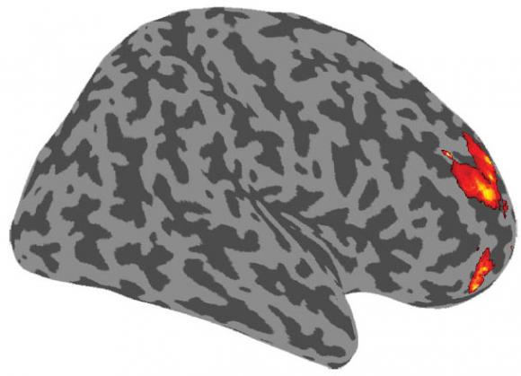
Relative Uncertainty in the brain: key areas for those who explore uncertain worlds
Rostrolateral preprontal cortex
Prefrontal cortex
Read more about the research:https://news.brown.edu/articles/2012/02/uncertainty

Slide 14
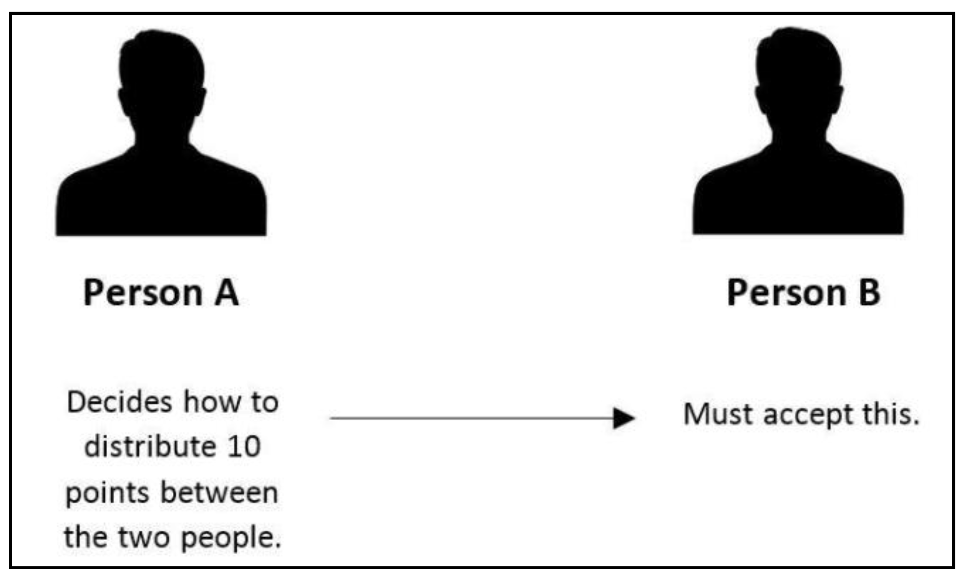
Moving to Decisions within social Interactions
Dictator Game

Slide 15
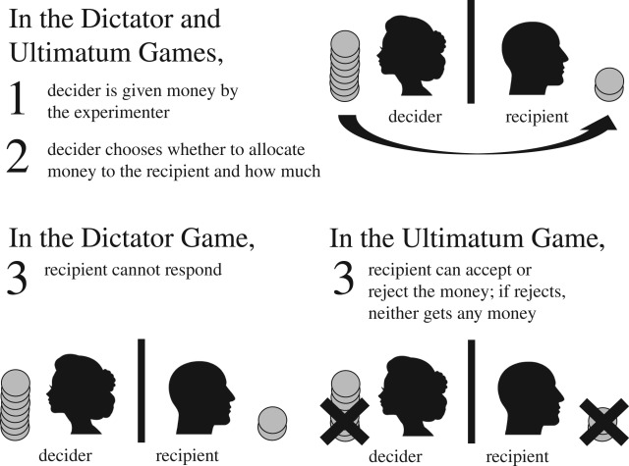

Slide 16
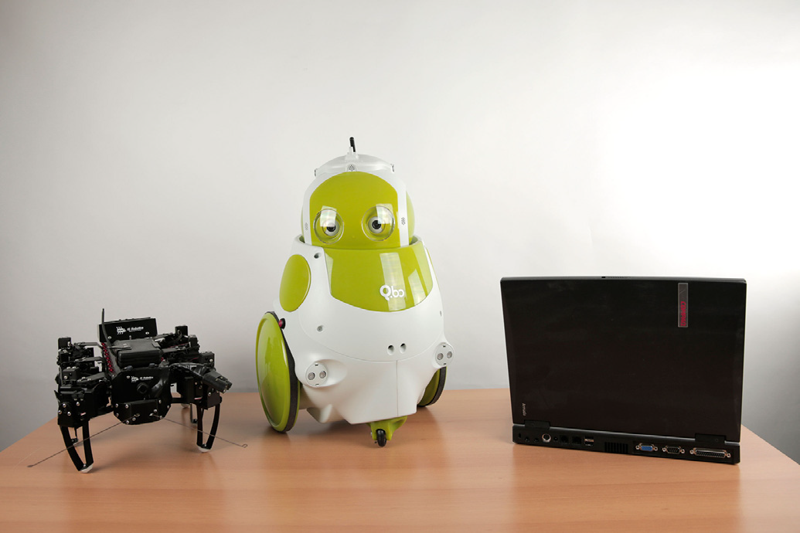
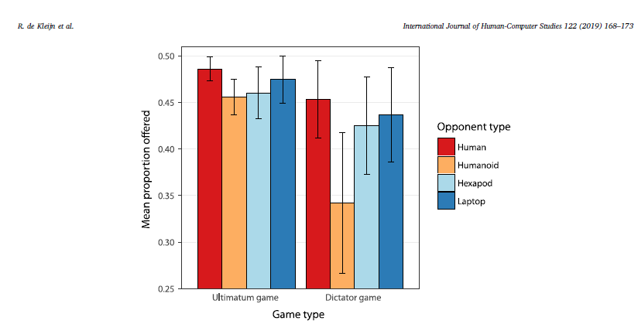
Deciding (humans with Non-human agents)

Slide 17
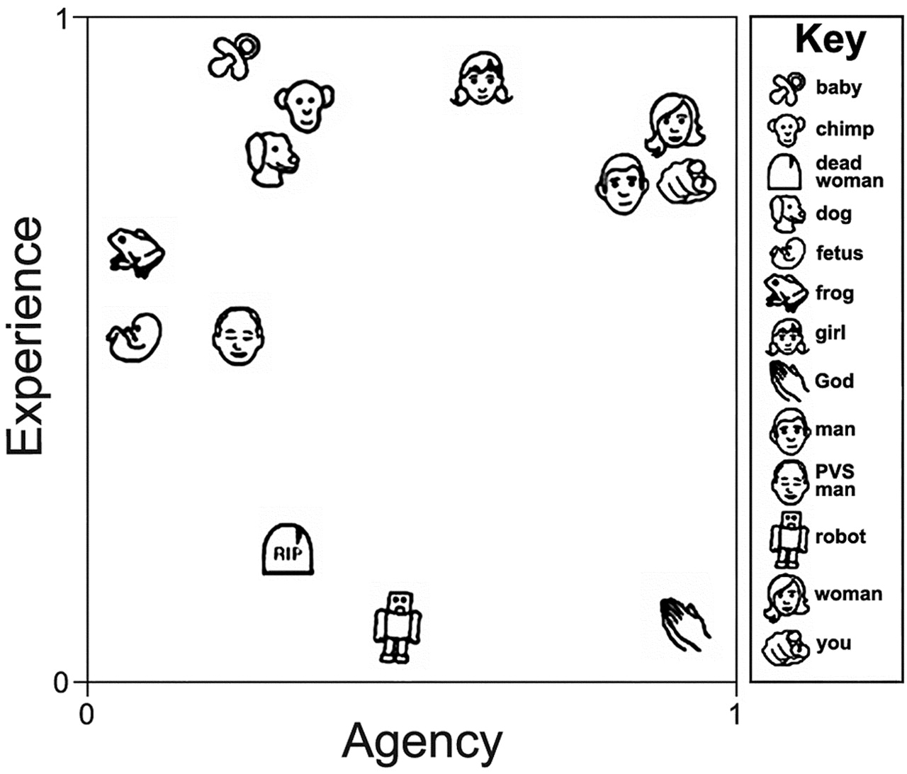
The strange, interesting and amazing mind judging other minds: Mind Perception
Gray, Gray & Wegner, 2007. Science, 315(5812), 619

Slide 18
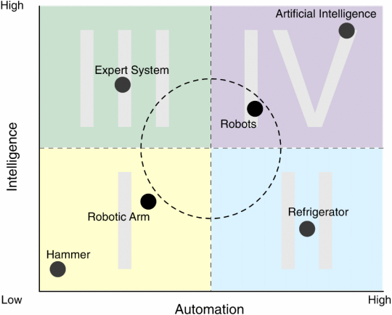
Humans and Technology

